Slide 1

Responsible AI toolkits

Slide 2
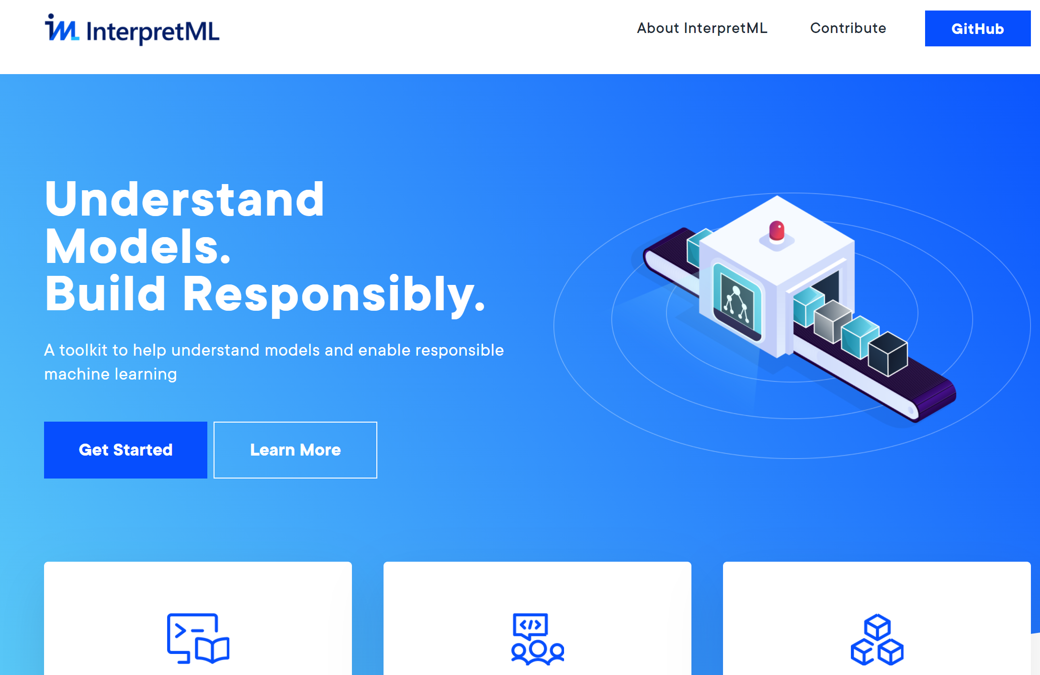
InterpretML

Slide 3
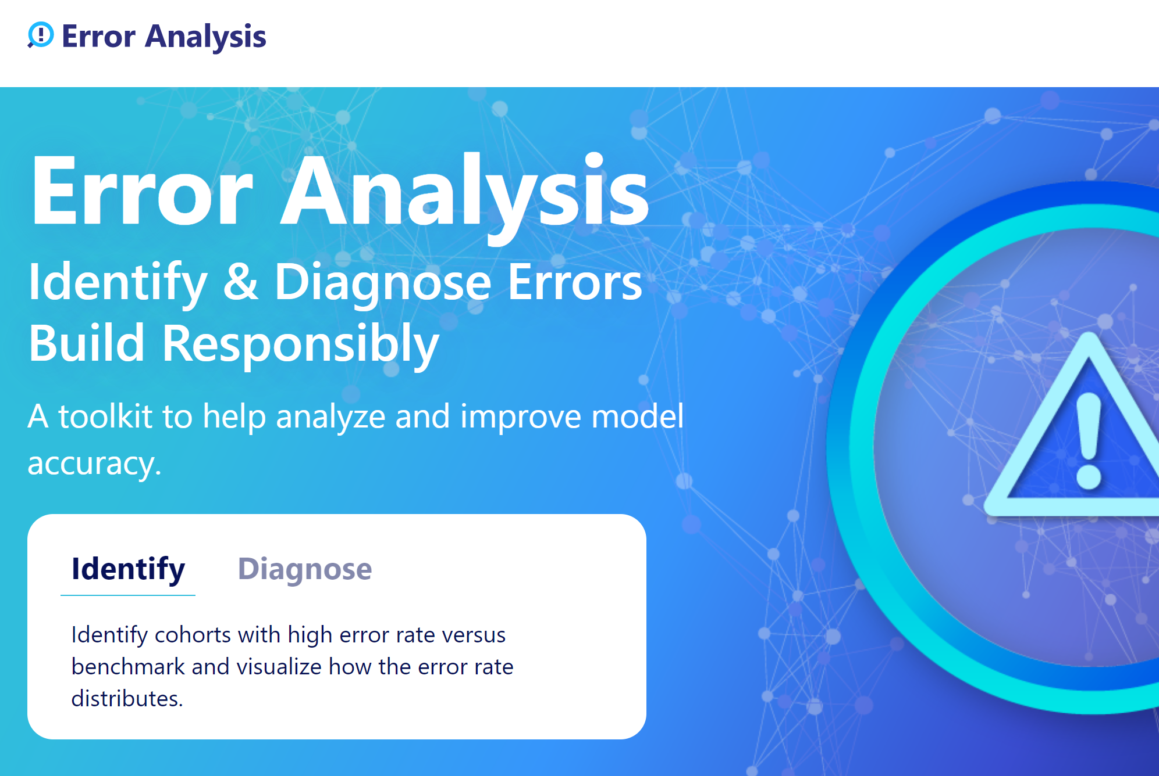
Error Analysis

Slide 4
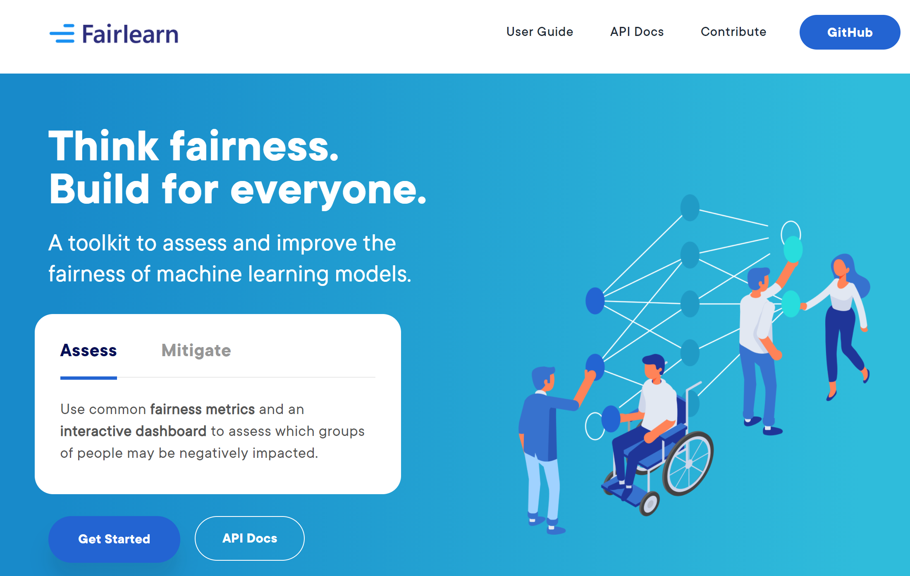
Fairlearn

